Slide 1

afcharts
Olivia Box Power
04/09/2025

Slide 2
Why did we create afcharts?
The government analysis function produces a lot of guidance for data visualisation, including recommended categorical and sequential colour palettes.
We wanted an easy way for analysts to apply this guidance when using code to produce charts.
The ggplot2 R package is a popular (and free) choice for producing static data visualisations.
If you don’t have time to write a package yourself, steal someone else’s! An analyst in the Scottish Government produced an R package called sgplot, which largely follows the analysis function data visualisation guidance. We then modified this package (with permission!) to create afcharts, branded for the analysis function.

Slide 3
How do we work on afcharts?
afcharts is maintained and developed by the data visualisation tools subgroup of the GSS (Government Statistical Service) Presentation Champions network. We have members from across different government departments (DHSC, ONS, UKHSA, OFQUAL, Welsh Government, OFSTED…)
Any government analyst is welcome to join the group (although R package development experience is beneficial).
We encourage users of the package to submit issues, suggestions and queries on github.

Slide 4
DEMO

Slide 5
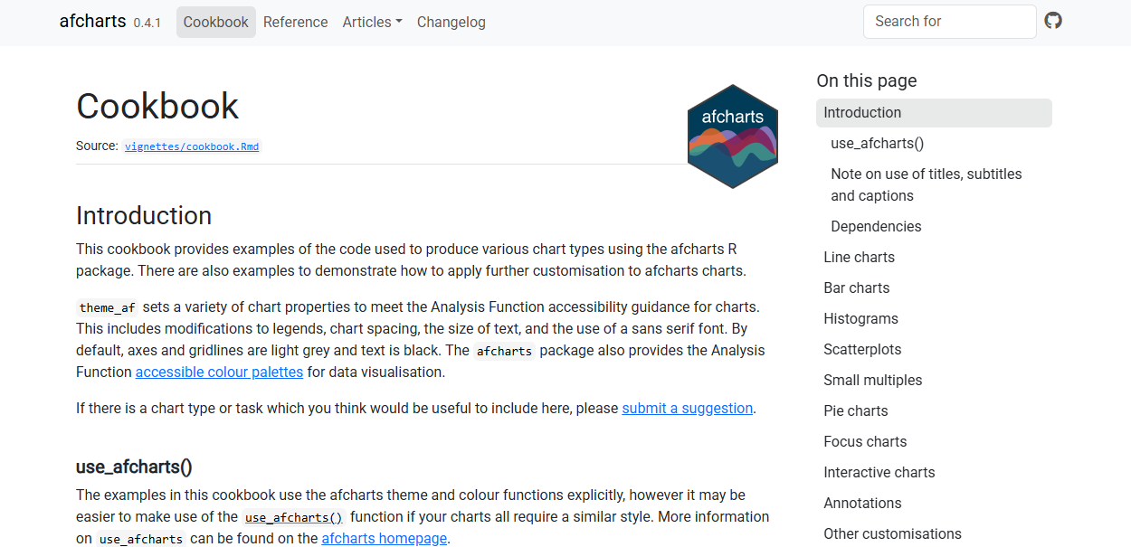
afcharts cookbook

Slide 6
Future package developments
Increase the number of colour palettes in the package (Red-Amber-Green, Diverging).
Provide support for interactive charts (using R packages plotly or ggiraph?)
Provide support for producing choropleth maps.

