Slide 1
Accessibility in Power BI
Elliot Bridges
Senior Data and Insights Analyst
Elliot.Bridges@HFEA.gov.uk
4th September 2025

Slide 2
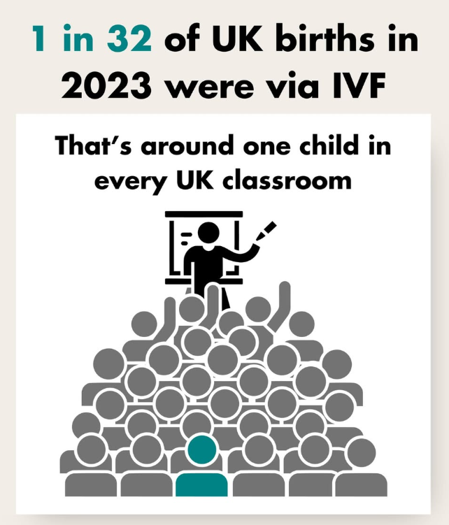
UK fertility sector
Around 1 in 7 couples may have difficulty conceiving
Human Fertilisation and Embryology Act 1990 established regulation of:
Fertility treatment
Embryo research
Hold data on around:
1,700,000 IVF treatments
280,000 Donor Insemination (DI) treatments

Slide 3
Accessibility in Power BI
Wanted to develop dashboard to improve data availability
Limited resources publicly available on Power BI accessibility
Accessibility functions we were able to include
Provide visual information as text
Keyboard navigation
Alt texts
Accessibility functions we were not able to include
Page structure
Mobile view

Slide 4
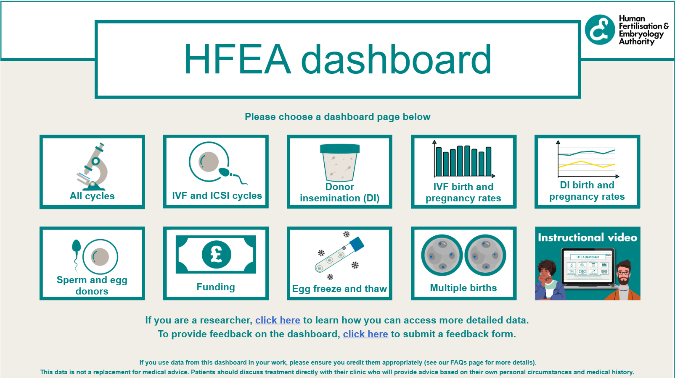
Dashboard

Slide 5
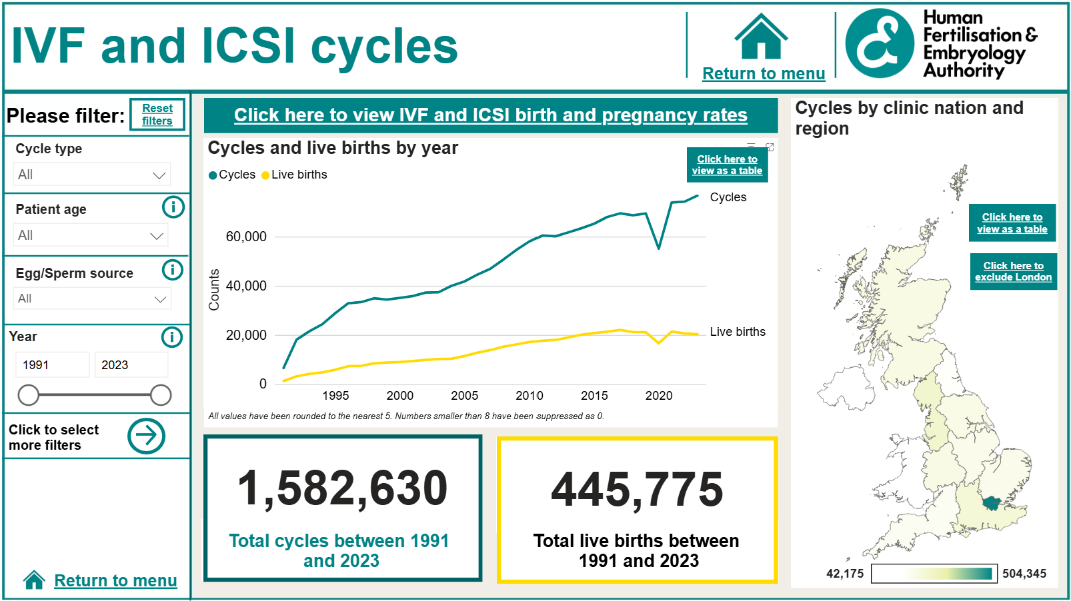
Dashboard

Slide 6
Table view

Slide 7
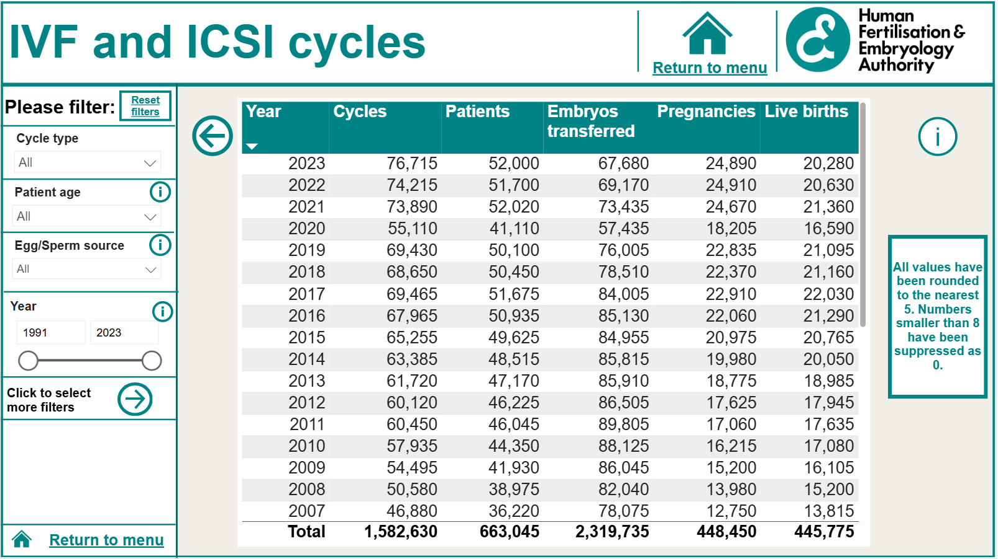
Table view

Slide 8
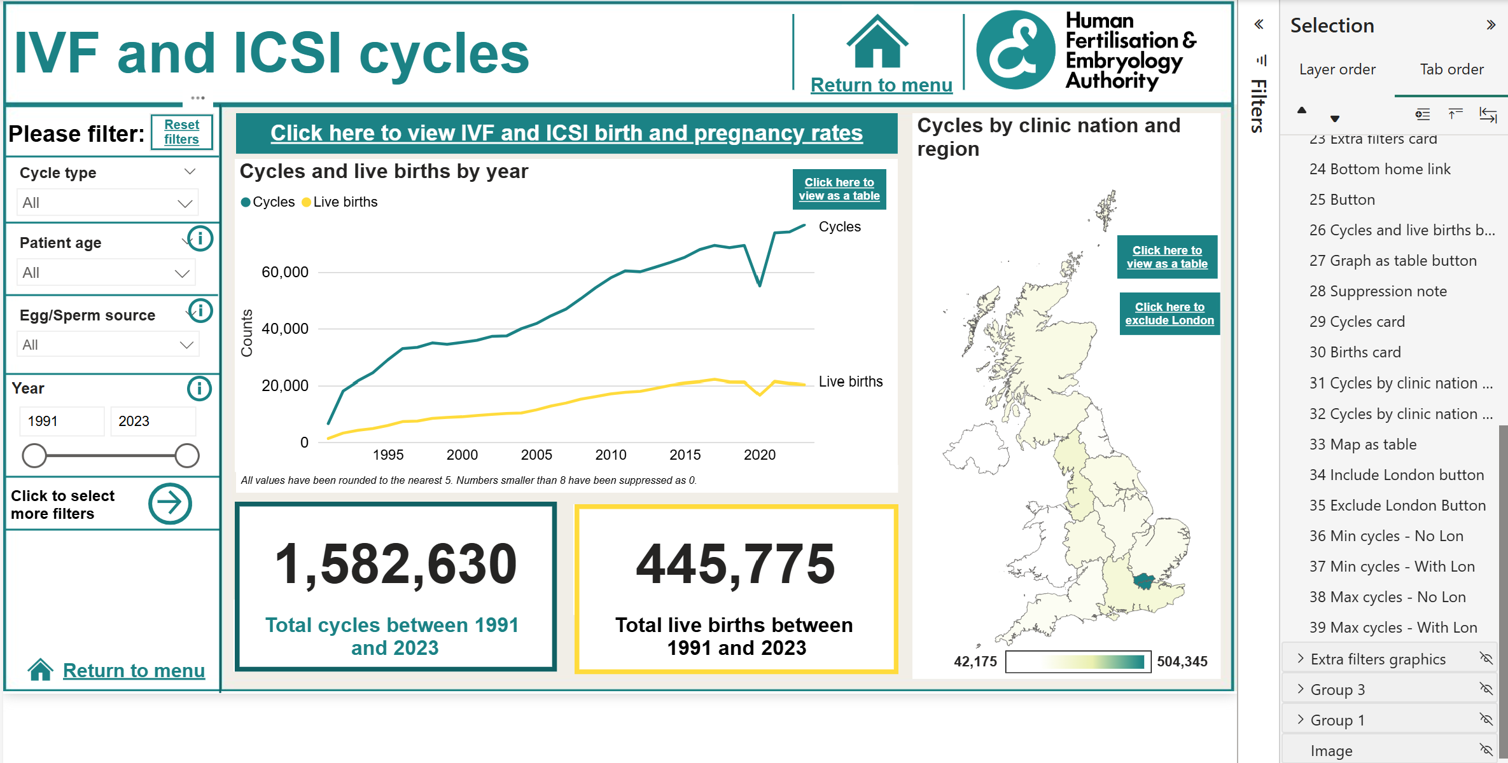
Keyboard navigation setup
Drag and drop to select tab order
Can hide decorative elements

Slide 9
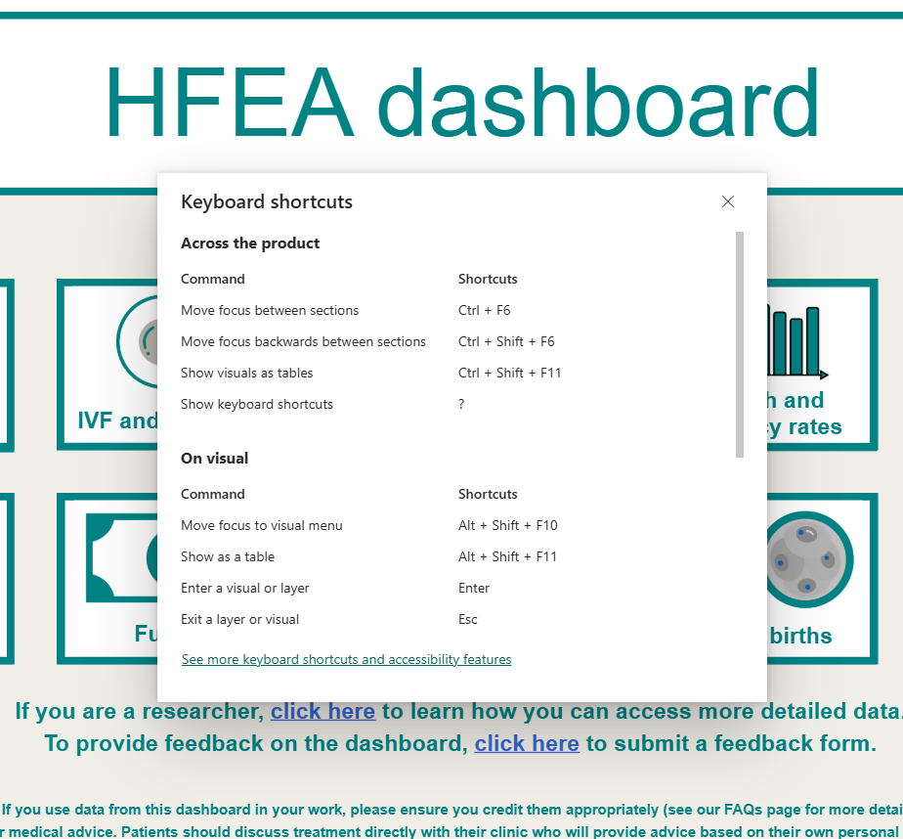
Keyboard navigation issues
When first load page, can’t immediately interact with dashboard
Submenu first to see keyboard shortcuts
Instructions relatively complicated
For most things, navigation easy to use
For graphs, tables, etc, navigation more complicated

Slide 10
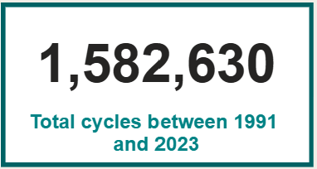

Alt text
Simple for non-interactive objects
For interactive objects, can set up but requires code
For graphs / tables, we include navigation instructions in alt text
Issue – Can’t change start / end of alt text
total cycles between 1991 and 2023 were 1,582,630 img
Page navigation dot click here to return to home page img

Slide 11
Accessibility functions we were not able to include
Mobile view
Used same version as desktop view
Dedicated mobile view requires users to install app
Can’t set different view for mobile web browsers in Power BI
Page structure
Can’t set up to have a single column on zoom
Can’t edit heading structure / role assignments
High contrast view complicated to set up

Slide 12

Any questions?
Elliot.Bridges@hfea.gov.uk
www.hfea.gov.uk

